Slide 1
CLASSES AND OBJECTS

Slide 2
Using object as a parameter

Slide 3
class Test
{ int a, b;
Test(int i, int j)
{ a = i;
b = j; }
boolean equals( Test o )
{
if(o.a == a && o.b == b) return true;
else return false;
}
}

Slide 4
class PassOb
{
public static void main(String args[])
{
Test ob1 = new Test(100, 22);
Test ob2 = new Test(100, 22);
Test ob3 = new Test(-1, -1);
System.out.println("ob1 == ob2: " + ob1.equals(ob2));
System.out.println("ob1 == ob3: " + ob1.equals(ob3));
}
}

Slide 5
// Here, Box allows one object to initialize another.
class Box
{ double width; double height; double depth;
// construct clone of an object
Box(Box ob)
{ width = ob.width;
height = ob.height;
depth = ob.depth;
}
Box(double w, double h, double d)
{ width = w;
height = h;
depth = d; }

Slide 6
Box()
{ width = -1;
height = -1;
depth = -1;
}
// constructor used when cube is created
Box(double len)
{ width = height = depth = len;
}
double volume()
{ return width * height * depth;
}
}

Slide 7
class OverloadCons2
{ public static void main(String args[])
{
Box mybox1 = new Box(10, 20, 15);
Box mybox2 = new Box();
Box mycube = new Box(7);
Box myclone = new Box(mybox1);
double vol;
vol = mybox1.volume();
System.out.println("Volume of mybox1 is " + vol);
}
}

Slide 8
Argument Passing
// Simple types are passed by value.
class Test
{ void meth(int a)
{ a = a+10;
}
}
class CallByValue
{ public static void main(String args[])
{ Test ob = new Test();
int a = 15;
System.out.println(“value of a before call: " + a );
ob.meth(a);
System.out.println(“value of a after call " +a); } }

Slide 9
// Objects are passed by reference.
class Test
{ int a, b;
Test(int i, int j)
{ a = i;
b = j;
}
// pass an object
void meth(Test o)
{
o.a = o.a+ 10;
o.b = 0.b - 10;
}
}

Slide 10
class CallByRef
{
public static void main(String args[])
{
Test ob = new Test(15, 20);
System.out.println("ob.a and ob.b before call: " +ob.a + " " + ob.b);
ob.meth(ob);
System.out.println("ob.a and ob.b after call: " +ob.a + " " + ob.b);
}
}

Slide 11
Returning objects
// Returning an object.
class Test
{ int a;
Test(int i)
{ a = i;
}
Test incrByTen()
{
Test temp = new Test(a+10);
return temp;
}
}

Slide 12
class RetOb
{ public static void main(String args[])
{
Test ob1 = new Test(2);
Test ob2;
ob2 = ob1.incrByTen();
System.out.println("ob1.a: " + ob1.a);
System.out.println("ob2.a: " + ob2.a);
ob2 = ob2.incrByTen();
System.out.println("ob2.a after second increase: “+ ob2.a);
}
}

Slide 13
ob1.a: 2
ob2.a: 12
ob2.a after second increase: 22

Slide 14
Recursion
The process in which a function calls itself is called recursion.
The corresponding function is called as recursive function.
class Factorial
{ int fact(int n)
{
int result;
if(n==1) return 1;
result = fact(n-1) * n;
return result;
}
}

Slide 15
class Recursion
{
public static void main(String args[])
{
Factorial f = new Factorial();
System.out.println("Factorial of 3 is " + f.fact(3));
System.out.println("Factorial of 4 is " + f.fact(4));
System.out.println("Factorial of 5 is " + f.fact(5));
}
}

Slide 16
// Another example that uses recursion.
class RecTest
{ int values[];
RecTest(int i)
{ values = new int[i];
}
// display array -- recursively
void printArray(int i)
{
if(i==0) return;
else printArray(i-1);
System.out.println("[" + (i-1) + "] " + values[i-1]);
}
}

Slide 17
class Recursion2
{
public static void main(String args[])
{
RecTest ob = new RecTest(10);
int i;
for(i=0; i<10; i++)
ob.values[i] = i;
ob.printArray(10);
}
}

Slide 18
[0] 0
[1] 1
[2] 2
[3] 3
[4] 4
[5] 5
[6] 6
[7] 7
[8] 8
[9] 9

Slide 19
INHERITANCE

Slide 20
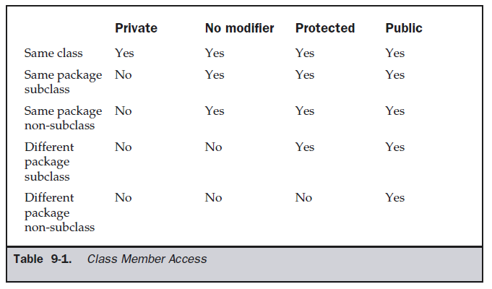
Access Protection

Slide 21
class A
{
int a;
private int b;
protected int c;
}

Slide 22
Inheritance
A subclass is a specialized version of a superclass.
A subclass inherits all the instance variables and methods from the superclass and adds its own unique elements.
Inheritance is facilitated in Java with the help of the keyword extends.

Slide 23
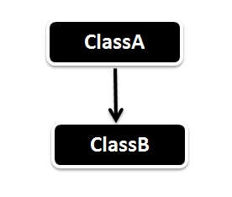
1 Single Inheritance
Super class, parent class, base class
Subclass, child class, derived class

Slide 24
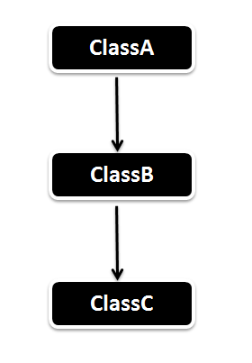
2 Multilevel Inheritance

Slide 25
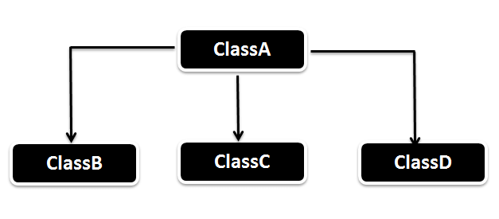
3 Hierarchical Inheritance

Slide 26
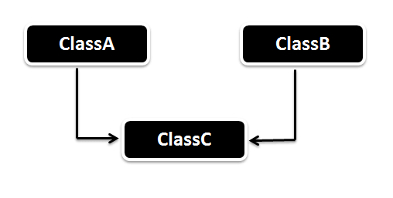
4 Multiple Inheritance
Not supported in java

Slide 27
class subclass-name extends superclass-name
{
// body of class
}

Slide 28
class A
{
}
class B extends A
{
}

Slide 29
class MyMessage1
{
void dispMessage1()
{
System.out.println(“Wel come”);
}
}
class MyMessage2 extends MyMessage1
{
void dispMessage2()
{
System.out.println(“MIT, Manipal”);
}
}
class SimpleInheritance
{ public static void main(String args[])
{
MyMessage2 m2 = new MyMessage2();
m2.dispMessage1();
m2.dispMessge2()
}
}

Slide 30
class A
{ int i, j;
void showij()
{ System.out.println("i and j: " + i + " " + j);
}
}
class B extends A
{ int k;
void showk()
{ System.out.println("k: " + k);
}
void sum()
{ System.out.println("i+j+k: " + (i+j+k));
}
}

Slide 31
class SimpleInheritance
{ public static void main(String args[])
{
B subOb = new B();
subOb.i = 7;
subOb.j = 8;
subOb.k = 9;
System.out.println("Contents of subOb: ");
subOb.showij();
subOb.showk();
subOb.sum();
}
}

Slide 32
Member Access and Inheritance
derived cannot access members of the superclass that have been declared as private.

Slide 33
/* private members remain private to their class */
class A
{ int i;
private int j; // private to A
void setij(int x, int y)
{ i = x;
j = y;
}
}
class B extends A
{ int total;
void sum()
{ total = i + j; // ERROR, j is not accessible here
}
}

Slide 34
//This program uses inheritance to extend Box.
class Box {
double width;
double height;
double depth;
Box(Box ob) // construct clone of an object
{ width = ob.width;
height = ob.height;
depth = ob.depth;
}
Box(double w, double h, double d)
{ width = w;
height = h;
depth = d;
}

Slide 35
Box()
{ width = -1; // use -1 to indicate
height = -1; // an uninitialized
depth = -1; // box
}
// constructor used when cube is created
Box(double len)
{ width = height = depth = len;
}
double volume()
{ return width * height * depth;
}
}

Slide 36
class BoxWeight extends Box
{ double weight;
BoxWeight(double w, double h, double d, double m)
{ width = w;
height = h;
depth = d;
weight = m;
}
}

Slide 37
class DemoBoxWeight
{ public static void main(String args[])
{
BoxWeight mybox1 = new BoxWeight(10, 20, 15, 34.3);
BoxWeight mybox2 = new BoxWeight(2, 3, 4, 0.076);
double vol;
vol = mybox1.volume();
System.out.println("Volume of mybox1 is " + vol);
System.out.println(“Weight of mybox1 is " + mybox1.weight);
System.out.println();
vol = mybox2.volume();
System.out.println("Volume of mybox2 is " + vol);
System.out.println(“Weight of mybox2 is " + mybox2.weight);
} }

Slide 38
//Box is extended to include color
class ColorBox extends Box
{
int color; //color of Box
ColorBox(double w, double h, double d, int c)
{ width = w;
height = h;
depth = d;
color = c;
}
}

Slide 39
A superclass variable can reference a subclass object
The type of the reference variable (not the type of the object) determines what members can
be accessed.
when a reference to a subclass object is assigned to a superclass reference variable, we will
have access to only those parts of the object defined by the superclass.

Slide 40
A superclass variable can reference a subclass object
BoxWeight weightbox = new BoxWeight(3, 5, 7, 8.37);
Box plainbox = new Box();
double vol;
plainbox = weightbox;
vol = plainbox.volume();
System.out.println("Volume of plainbox is " + vol);
//following is invaild because plainbox does not define a weight member.
//System.out.println(“Weight of plainbox is " + plainbox.weight);

Slide 41
In the previous example,
weightbox is a reference to BoxWeight objects and plainbox is a reference to Box objects. Since BoxWeight is a subclass of Box, it is permissible to assign plainbox a reference to the weightbox object.
The type of the reference variable (not the type of the object) determines what members can be accessed.
ie, when a reference to a subclass object is assigned to a superclass reference variable, we will have access to only those parts of the object defined by the superclass.
Hence plainbox can’t access weight even when it refers to a BoxWeight object.

Slide 42
When Constructors Are Called
class A
{ A()
{ System.out.println("Inside A's constructor.");
}
}
// Create a subclass by extending class A.
class B extends A
{ B()
{ System.out.println("Inside B's constructor.");
}
}
class C extends B
{ C()
{ System.out.println("Inside C's constructor.");
}
}

Slide 43
class CallingCons
{
public static void main(String args[])
{
C c = new C();
}
}

Slide 44
The output from this program is shown here:
Inside A’s constructor
Inside B’s constructor
Inside C’s constructor

Slide 45
  METHOD OVERRIDING

Slide 46
// Method overriding.
class A
{
int i, j;
A(int a, int b)
{
i = a;
j = b;
}
// display i and j
void show()
{
System.out.println("i and j: " + i + " " + j);
}
}

Slide 47
class B extends A
{ int k;
B(int a, int b, int c)
{ super(a, b);
k = c;
}
// display k – this overrides show() in A
void show()
{
System.out.println("k: " + k);
}
}
class Override
{
public static void main(String args[])
{
B subOb = new B(1, 2, 3);
subOb.show(); // this calls show() in B
}
}

